Slide 2
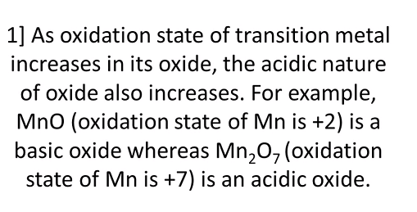

Slide 5
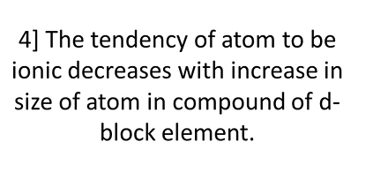

Slide 7
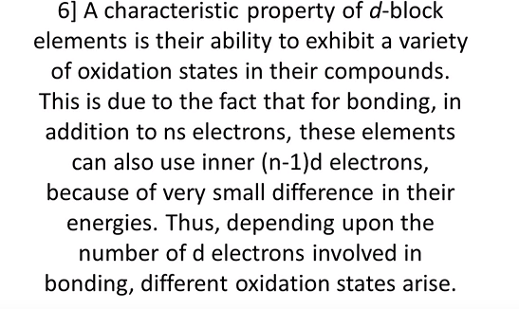

Slide 8
+2 | +8/3 | +3 | +4 | +7
MnO | Mn3O4 | Mn2O3 | MnO2 | Mn2O7

Slide 9
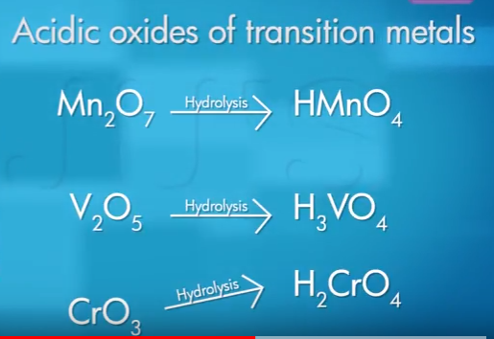

Slide 10
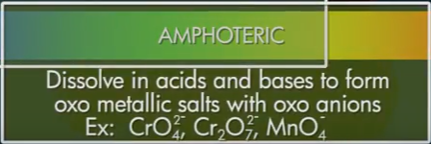

Slide 11
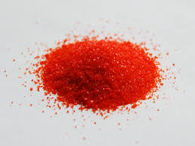
Potassium Dichromate is an orange to red colored, crystalline, inorganic compound that emits toxic chromium fumes upon heating. Potassium dichromate is highly corrosive and is a strong oxidizing agent.

Slide 13
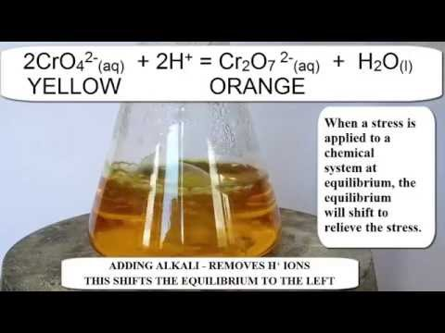

Slide 15
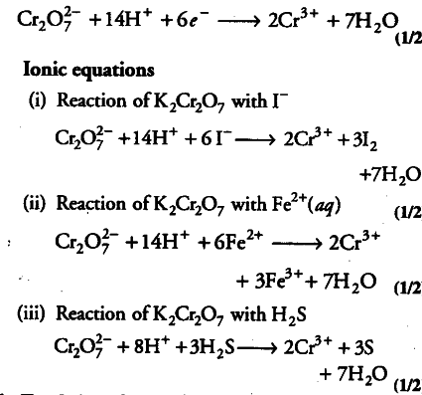

Slide 16
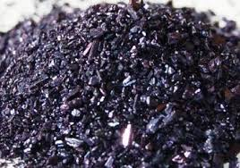
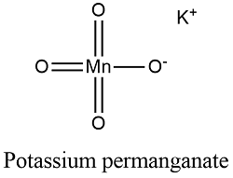
POTASSIUM PERMANGANATE

